Slide 1
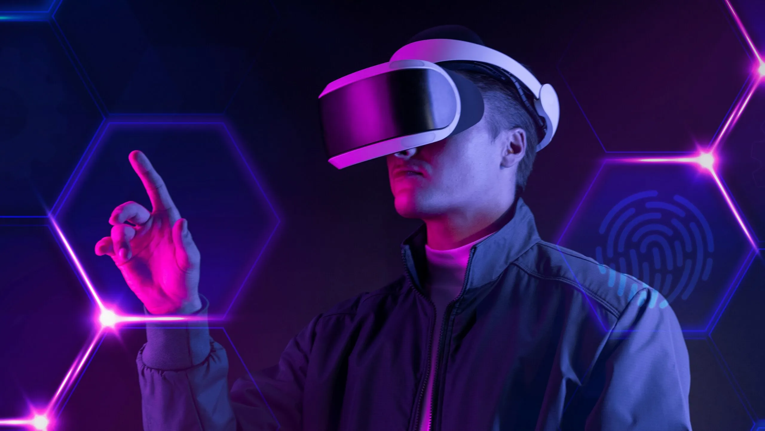
Name : Hamza Sarwar
Roll No : PIAIC202301
Center : UMT (Lahore)
Batch - 39 | Time - 02:00 to 06:00
How Metaverse Will Revolutionize Everything

Slide 2
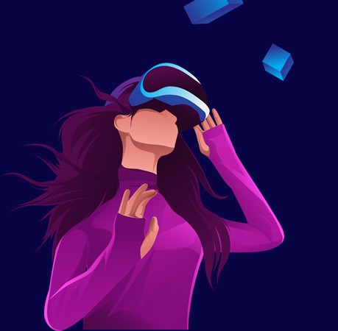
When Will the Metaverse Arrive?
“The Metaverse is not a Future, it’s already here. It’s a Conversation about becoming, not simply being.”

Slide 3
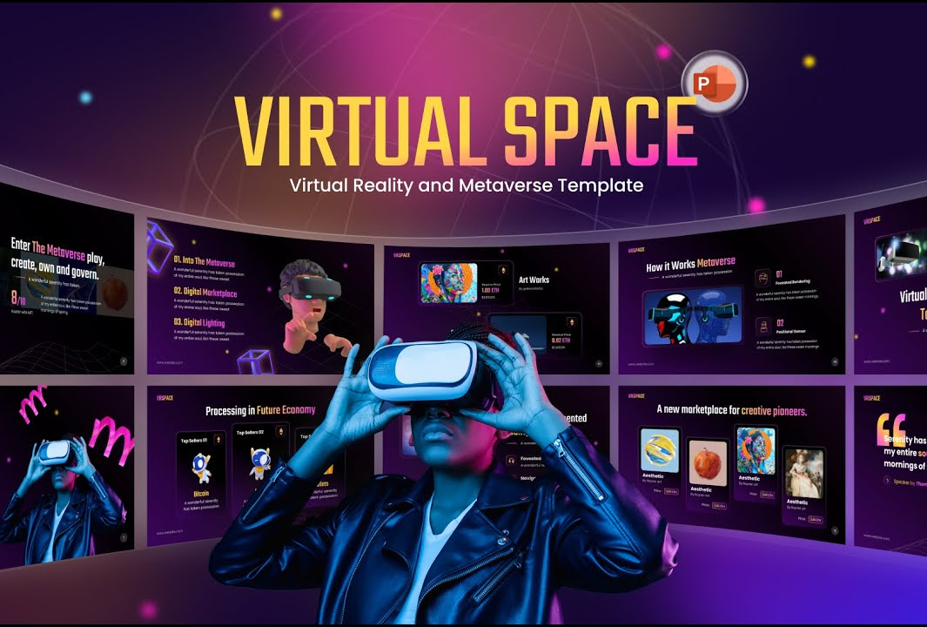
Metaverse Businesses
Metaverse platforms have the potential to transform how, when and where companies interact with their customers, as extended reality platforms enable businesses to deliver new experience and provide information in new ways.
Branded gaming adventures, virtual goods, and AR/VR showrooms can be the options for representing your business in the metaverse. Don't wait up and think about collaborating with interactive design companies before it becomes mainstream.

Slide 4
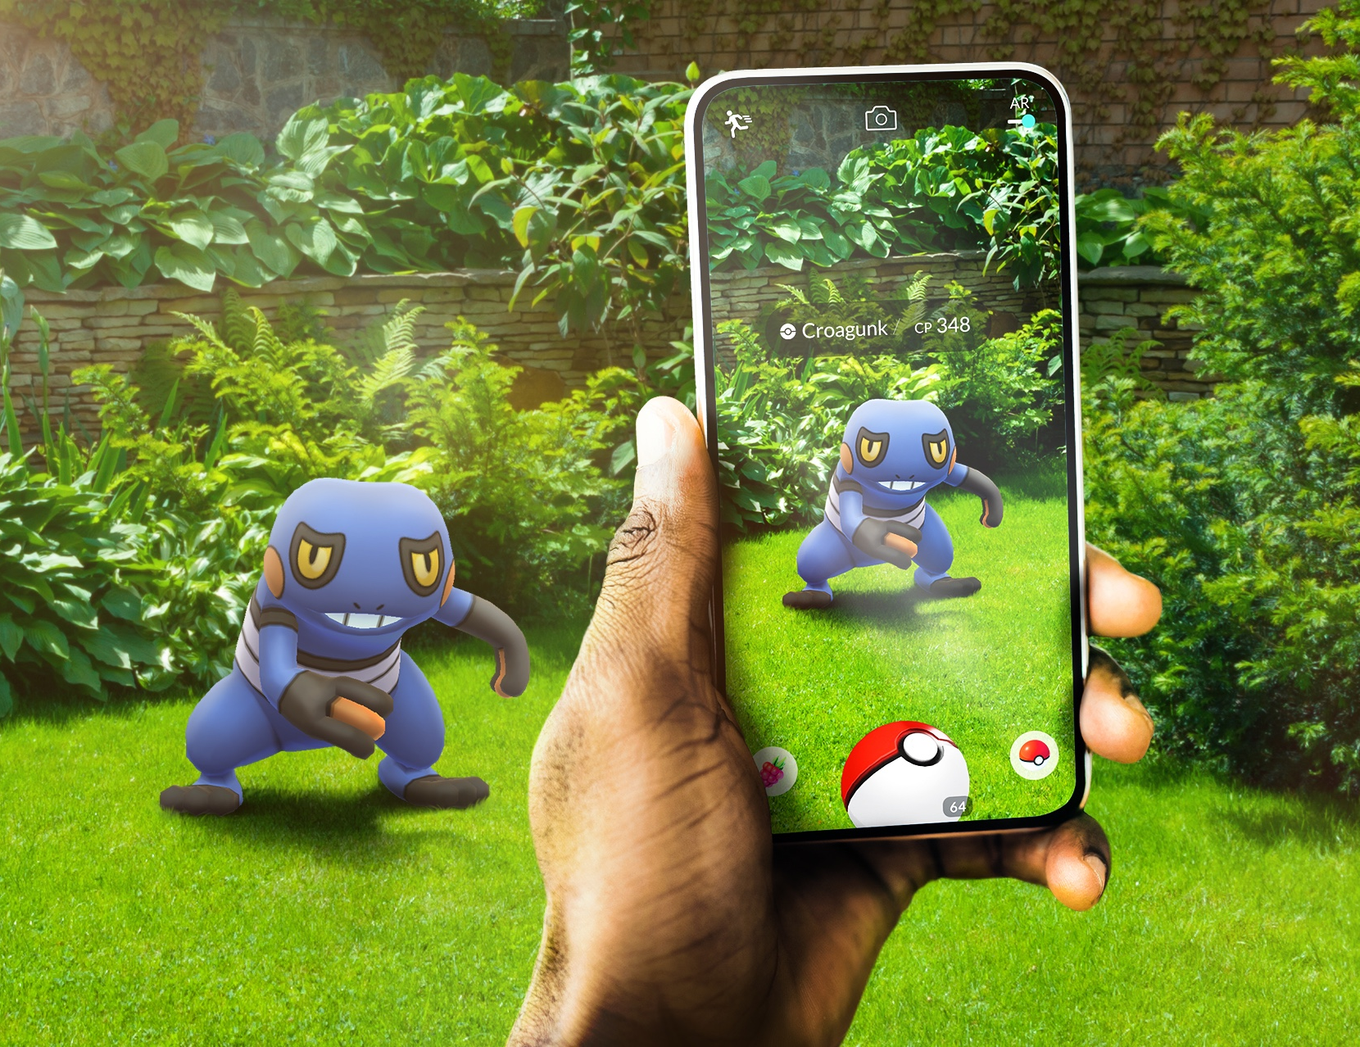
Metaverse Existence
Since Niantic first launched Pokemon Go and Ready Player One hit the big screen, many brands have been wondering whether or not they should be getting involved with the metaverse. This is somewhat misguided because it doesn't exist in the way that they think it does – yet.
How many platforms exist in the metaverse? Well, there are more in the developing phase than you could even imagine. Therefore, while we can't pin down a number to answer this question “how many metaverse platforms are there?”, an estimation would be more than 10,000 virtual worlds.

